Slide 1
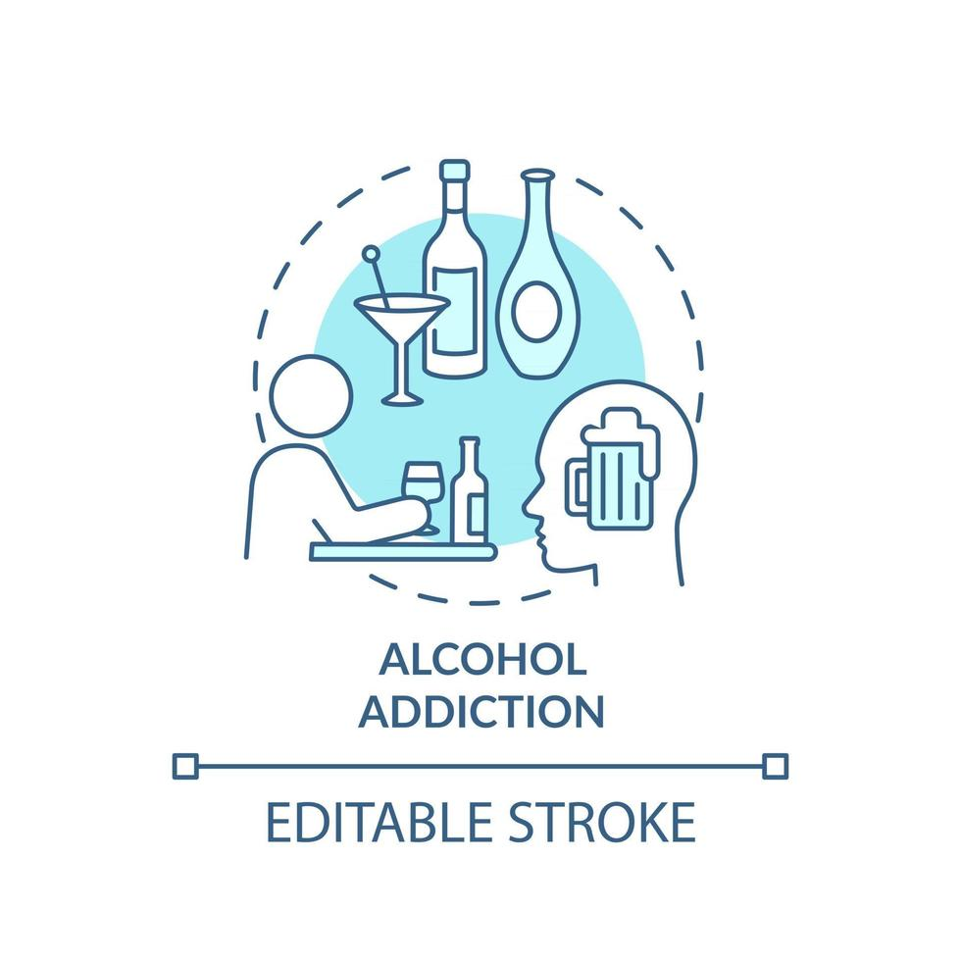

Biomedical Wearable Technologies for Healthcare and Wellbeing
SDG 3: Ensure Healthy lives and promote well-being for all at all ages.
Target 3.5: Strengthen the prevention and treatment of substance abuse, including narcotic drug abuse and harmful use of alcohol.
Sara Fazio
Emma Ghezzo
Mariapia Cecere

Slide 2
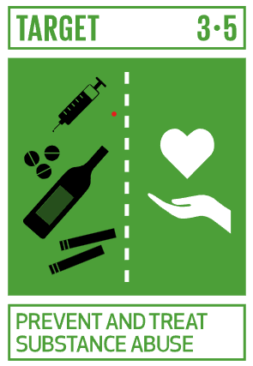
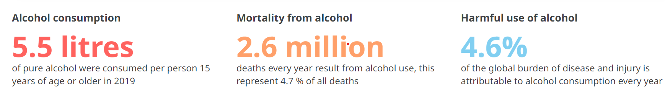
Background
It can be hard to identify the lines between an occasional drinking and unhealthy alcohol use. In general, when people continue to drink alcohol despite negative social, health and possibly legal effects, it can be said that their drinking is “unhealthy”: excessive drinking increases the risk of developing Alcohol Use Disorder (AUD). Fortunately, AUD is a treatable disease: with the use of effective medications and therapies, people can recover from AUD.
Notes:
Background - What’s the ”story” behind your app? Is it for healthy people? Is it targeting any disease?
-Worldwide, around 2.6 million deaths were caused by alcohol consumption in 2019.
-An estimated 400 million people, or 7% of the world’s population aged 15 years and older, lived with alcohol use disorders.
-In 2019, alcohol consumption in the world, measured in litres of pure alcohol per person of 15 years of age or older, was 5.5 litres, which is a 4.7% relative decrease from 5.7 litres in 2010.
-Access to screening, brief intervention and treatment for people with hazardous alcohol use and alcohol use disorder remains very low, as well as access to medications for treatment of alcohol use disorders. Overall, the proportion of people with alcohol use disorders in contact with treatment services varies from less than 1% to no more than 14% in all countries where such data are available.
It can be hard to identify the lines between casual and occasional drinking and unhealthy alcohol use including alcohol use disorder.
In general, when people continue to drink alcohol despite negative social, health, and possibly legal consequences, it can be said that their drinking is “unhealthy.”
Whether it takes the form of frequent or daily alcohol use or binge drinking, excessive drinking increases the risk of developing alcohol use disorder (AUD)
Fortunately, AUD is a treatable disease. With the use of appropriate medications and behavioral therapies, people can recover from AU

Slide 3
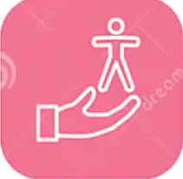
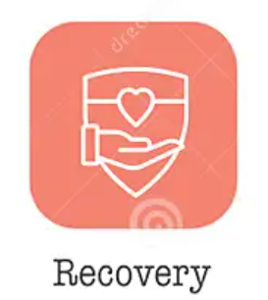
The task
Actual challenge maintain the treatment success
into everyday life, as many patients relapse without ongoing support.
App-based interventions strengthen the prevention and the treatment of harmful abuse of alcohol, offering a sustained and portable support system after hospital-based treatment.
Notes:
Problem to be solved/Feature to be provided to the public - What’s the target user/use case? What kind of problem your app is trying to solve? What’s missing in the current market (if some)? …
SDG 3: Target 3.5 (Strengthen the prevention and treatment of substance abuse, including narcotic drug abuse and harmful use of alcohol)
.. the transferal of treatment success into everyday life is challenging and many patients remain without further assistance. App-based interventions with human guidance have great potential to support individuals after inpatient treatment, yet evidence on their efficacy remains scarce…
however, support for cessation is not routinely offered to those diagnosed with ALD, and continued drinking or resumption of drinking after diagnosis is common. Mobile health (mHealth) has the potential to offer convenient and scalable support for alcohol cessation to those diagnosed with ALD,

Slide 4
Our solution
TrueNorth
Find your True North, Stay the Course
Description: TrueNorth is a comprehensive mobile application designed to enable individuals struggling with alcohol addiction to achieve and maintain long-term sobriety, interacting with a user-friendly interface.
Through its tools, the application aims to empower individuals to reclaim their lives, improve their health and well-being, and successfully navigate the journey of recovery.
Notes:
Your solution - High overview of your app (name, catchy motto, …). What do you want to enable with your app? …

Slide 5
Core app functionalities
Continuous incentive: promote users to enhance the effectiveness of their recovery efforts though challenges and rewards.
Self-Management: track progress, set goals and celebrate milestones, fostering a sense of control and achievement in users’ recovery process.
Motivation: remind the user of the reasons why to continue the taken course.
Notes:
Core app functionalities
• Screen map of your app
• User authentication and management - How do you do it? …
Getting data by IMPACT backend through HTTP requests/responses
Get token (JWT) using credentials
(if credentials are ok) Receive token
Ask for specific data using token
(if request is ok) receive data (JSON format)
• Data collection – How do you do it? …
Data are collecting by professor using a Fitbit Versa 2 (from 09/02 to 30/11). We are using:
Heart_Rate: a list of 1 data point every 5s → time (timestamp [hh:mm:ss format] of the heart rate entry) and value (heart rate at the current time [in bpm])
Resting_Heart_Rate: an entry per day → time (timestamp [hh:mm:ss format] of the resting heart rate entry [always 00:00:00]) and value (the estimated resting heart rate at the current time [in bpm])
Sleep: a list of 1 entry for each sleep session → minutesAsleep (the number of minutes asleep during the sleep entry)
• Data persistence – How do you manage data in your app (DB schema can be used here)? What’s the data flow inside your app? …
• Data visualization and presentation – How do you visualize user data in your app? …

Slide 6
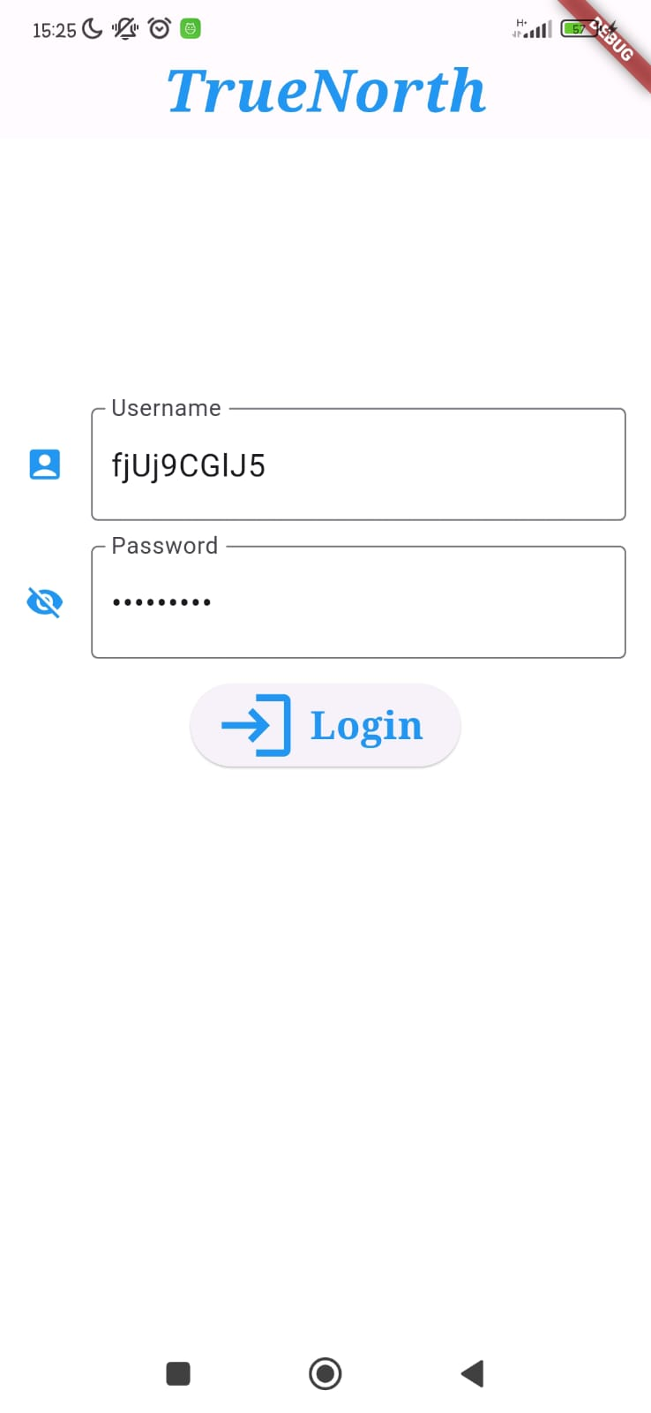
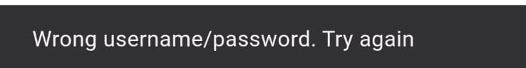
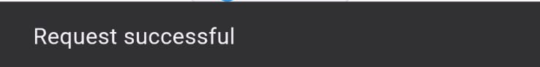
User authentication & management
Obtain data by IMPACT backend through HTTPS requests/responses:
1. Request token (JWT) using credentials
2. Receive token
2.1 If credentials are not correct the user has to try again
2.2 If request is valid, the JWT token is sent by the server
3. Ask for specific data using token
Notes:
HTTPS = main secure communication protocol for exchange data between the servers (IMPACT) and clients (users) = request-responce protocol in the TCP (application layer)
Since the data we used are private, we need to authenticate ourself. In order to do that we send a POST request to RESTful API to obtain (access and refresh) JWT token using our credentials.
If they are not correct, the server tells us that they are wrong, while if the request is valid we obtain the Token that we can use to access to the protected data in an HTTPS POST response.
Thanks to that, we can ask by GET requests for specifica data.

Slide 7
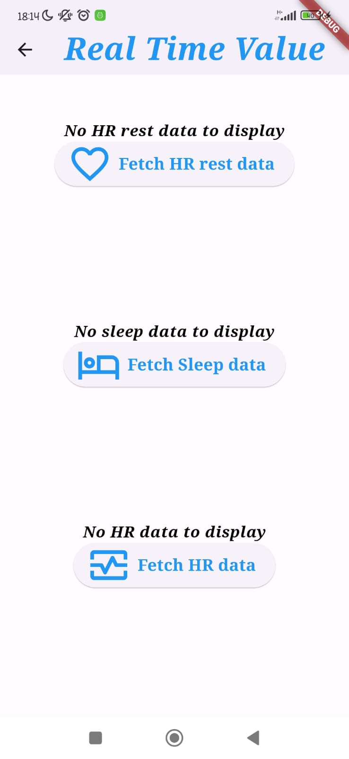
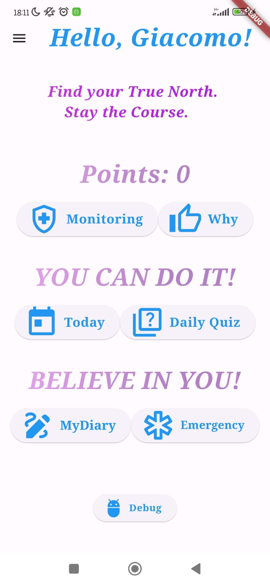
Data Collection and Visualization
Data were collected (from 09/02 to 30/11) by professor using the Fitbit Versa 2, a smartwatch for monitoring user’s health, and they are stored in the IMPACT server in a JSON format.
Daily data are fetched by pressing the button:
Daily data are plotted by creating a widget for each plot available in the Monitoring Route.
Notes:
The data we are using in this project are collected last year from our professor and we consider them as daily data. They are colleceted and stored in the IMPACT server in a JSON format in order to facilitate the automathed data processing, so we need to know how to read these structed data format.
In particular for our purpose, we choose the resting HR, HR and sleep data.
In fact, we used them in order to monitor the heath status of the application’s user, that can be and ex-alcoholic: he/she can be seen his realtime parameters by the plots in the monitoring section.

Slide 8
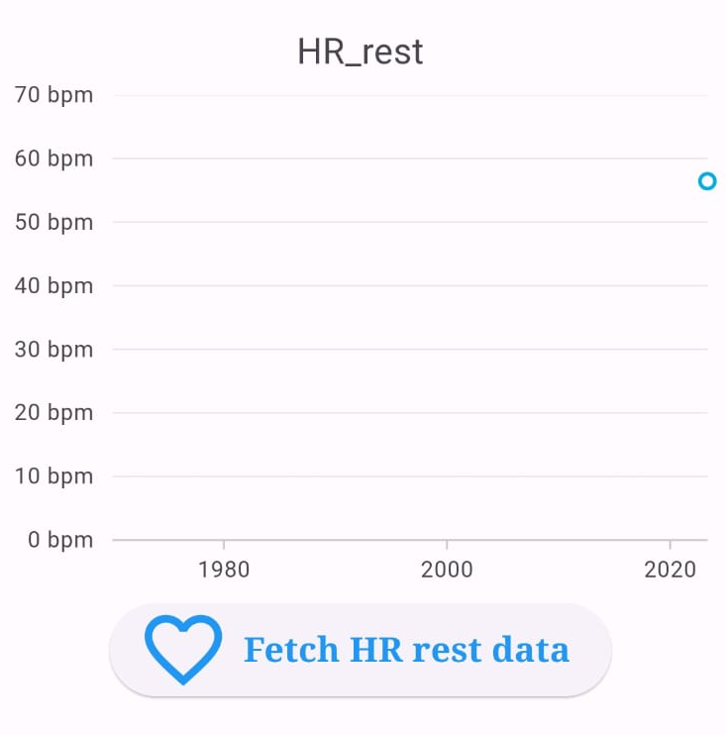
Resting Heart Rate
Resting_Heart_Rate: an entry per day
Time → timestamp [hh:mm:ss format] of the resting heart rate entry (always 00:00:00)
Value → the estimated resting heart rate at the current time [bpm]
Notes:
If we go more deeple we can see that the Resting HR is measured always at midnight and it is a single value per day, that is the estimated heart rate at the current time

Slide 9
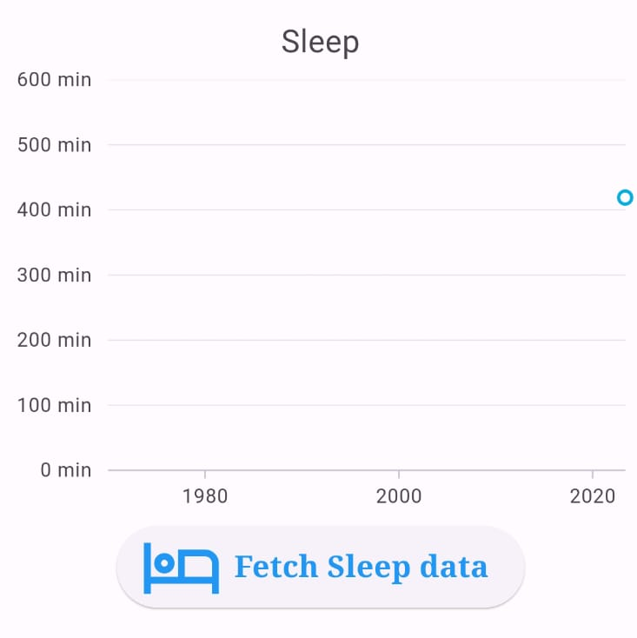
Sleep
Sleep: a list of 1 entry for each sleep session
MinutesAsleep → the number of minutes asleep during the sleep entry
Notes:
Than we used the sleep data: they are composed by a list of 1 entry for each sleep session (time of sessione, duration of the different sleep state [to fall asleep, asleep, aware],…) but we only used the Minutes ad sleep because we know that when someone is drunk he/she doen’t sleep a lot respect to a «normal» person.

Slide 10
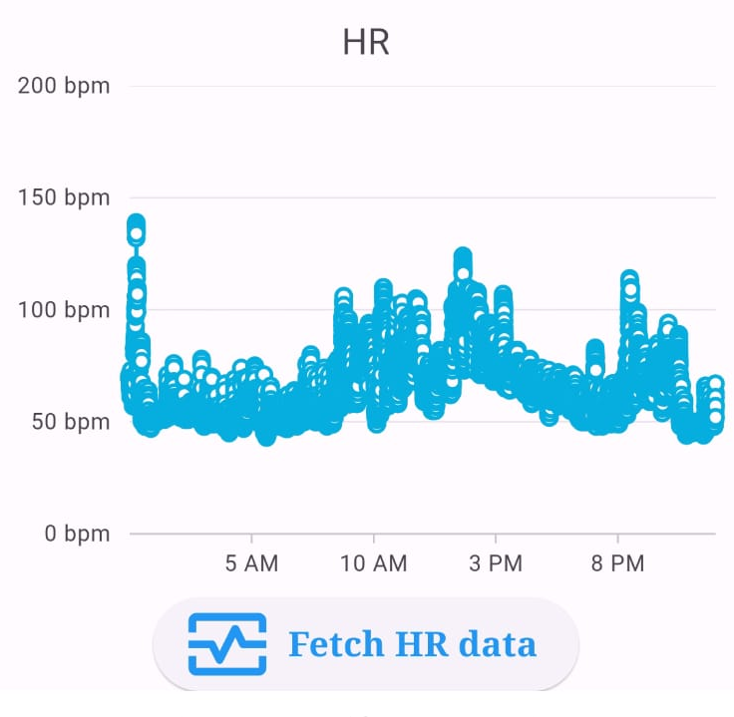
Heart Rate
Heart_Rate: a list of 1 data point every 5s
Time → timestamp [hh:mm:ss format] of the heart rate entry
Value → heart rate at the current time [bpm]
Notes:
Finally, we also use the HR data, that contain a list of 1 data point every 5s (continuos monitoring) and in particolar we consider the time of the measument and the value at the current time point.

Slide 11
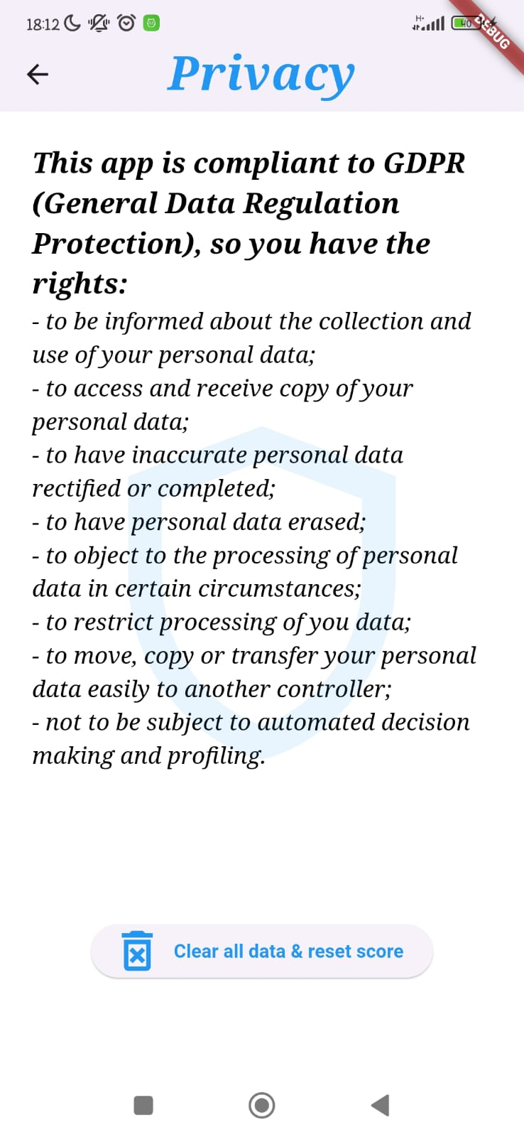
Data Persistence
Providing the data subjects with the Consent Form and Information Sheet and regarding their participation in the project, the data has been processed in accordance with GDPR. To fully comply with them (as much as possible), the Privacy section listed the rights of the user (data subject), ensuring the possibility to delete the processed data at any time.
Notes:
DB SCHEMA
Il database schema utilizzato nella persistenza dei dati di Impact include tipicamente diverse tabelle relazionali che memorizzano informazioni strutturate. Sebbene lo schema esatto possa variare a seconda dell'implementazione specifica, un esempio comune
Dati specifici (Specific Data): Tabelle che memorizzano i dati richiesti dagli utenti. Questo potrebbe includere vari tipi di dati specifici al dominio dell'applicazione, strutturati in tabelle diverse.
Log delle richieste (Request Logs): Registra le richieste HTTP effettuate dagli utenti, inclusi dettagli come l'ID utente, il timestamp della richiesta, e i dati richiesti. Permessi e ruoli (Permissions and Roles): Gestisce i permessi e i ruoli degli utenti, determinando quali dati e funzionalità sono accessibili a ciascun ruolo.
Queste tabelle interagiscono tra loro tramite relazioni chiave primaria-chiave esterna, garantendo l'integrità referenziale dei dati. Ad esempio, la tabella dei token di autenticazione avrà una chiave esterna che fa riferimento alla tabella degli utenti, collegando ogni token al suo utente specifico.

Slide 12
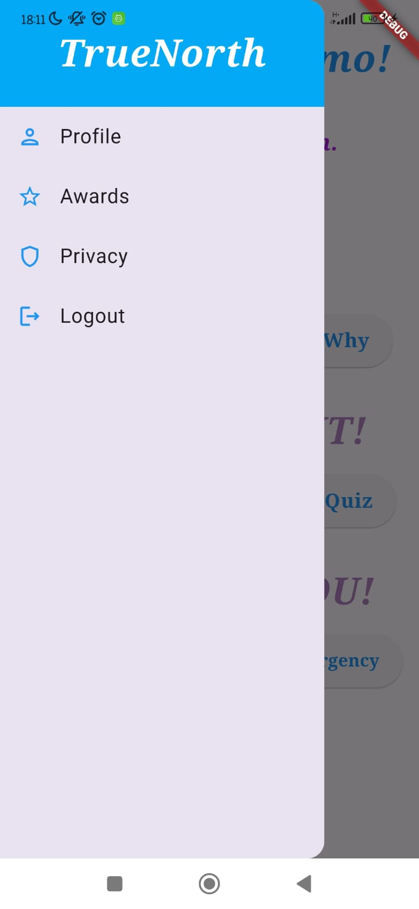
Our original implementations
Note: the debug button is used by us to set the initial conditions that simulate the use of the app in previous days.
Notes:
Daily quiz: questions that allow users to deepen his knowledge or to dispel common myths, as better understanding alcohol and its effects can make a big difference in his path to awareness and recovery.
We implement a daily questionnaire of 6 closed questions and for each correct answer the score is incremented by 1 point, for each incorrect answer the score’s deducted by 1 point.
Today: system that tries to recognize if the user is lying or if he/she is honest through a daily question.
In the page Today the app asks to the user if he had drunk or if he had used some dangerous substances for his health.
If the user answer YES, there is no control of the personal data, because it's obviously that user doesn't lie answering Yes.--> screen dell’app
And in the score we decrement 5 points, because he is honest.
If he answer NO, we check his personal data: in particular if HR rest > 80, mean of HR > 80 and sleep minutes < 240, the app notifies the user he is lying, because data are susceptible, and we decrement the score of 10 points
if from the collected data and the user's response it appears that he has not been drinking, the score increases by 10 points.

Slide 13
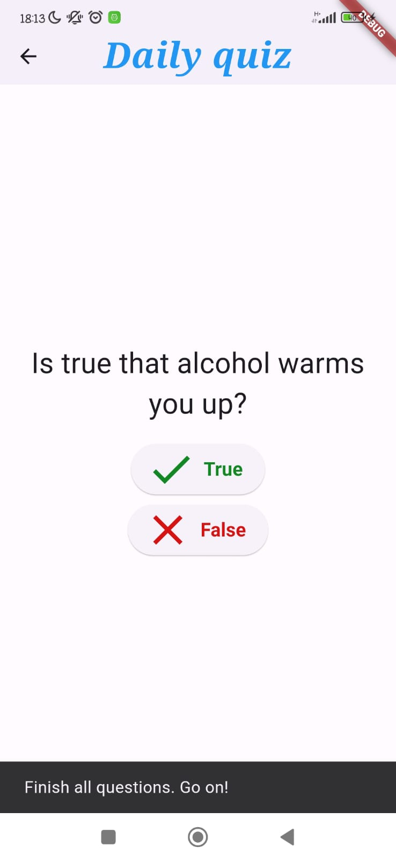
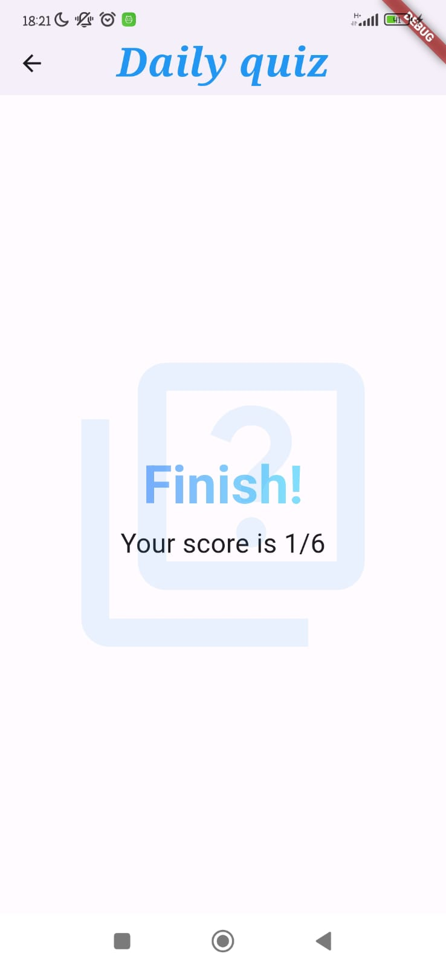
Daily Quiz
Daily questionnaire of 6 closed questions that
allows users to deepen his knowledge or to dispel common myths; for each correct answer the score is incremented by 1 point.
Notes:
Daily quiz: questions that allow users to deepen his knowledge or to dispel common myths, as better understanding alcohol and its effects can make a big difference in his path to awareness and recovery.
We implement a daily questionnaire of 6 closed questions and for each correct answer the score is incremented by 1 point, for each incorrect answer the score’s deducted by 1 point.
Today: system that tries to recognize if the user is lying or if he/she is honest through a daily question.
In the page Today the app asks to the user if he had drunk or if he had used some dangerous substances for his health.
If the user answer YES, there is no control of the personal data, because it's obviously that user doesn't lie answering Yes.--> screen dell’app
And in the score we decrement 5 points, because he is honest.
If he answer NO, we check his personal data: in particular if HR rest > 80, mean of HR > 80 and sleep minutes < 240, the app notifies the user he is lying, because data are susceptible, and we decrement the score of 10 points
if from the collected data and the user's response it appears that he has not been drinking, the score increases by 10 points.

Slide 14
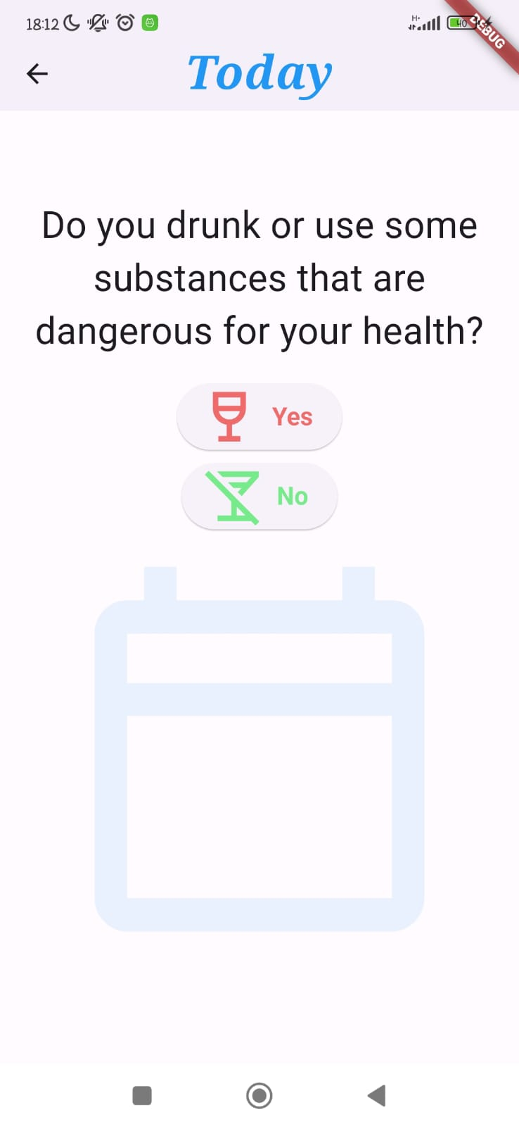
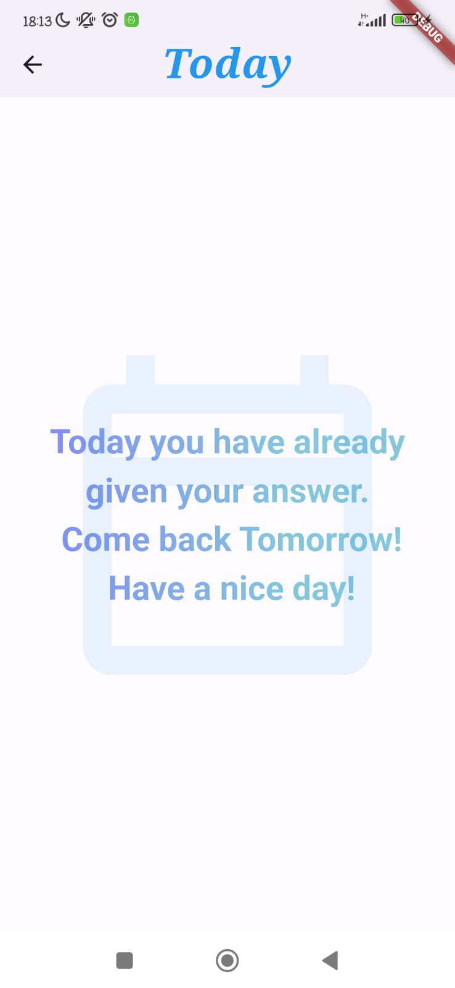
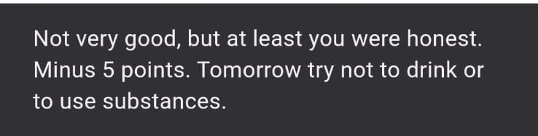
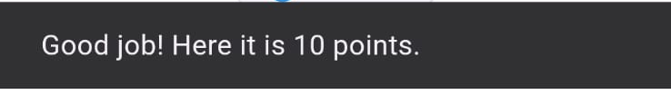
Today
System that tries to recognize if the user is lying or he/she is honest through a daily question.
Conditions to check:
HR rest > 80, mean of HR > 80 and sleep minutes < 240
Yes: -5 points to the score because the subject is honest.
Wrong No: -10 points because the user is lying and drunk.
Correct No: +10 points because from the collected data and the user's response it appears that he has not been drinking.
Notes:
Daily quiz: questions that allow users to deepen his knowledge or to dispel common myths, as better understanding alcohol and its effects can make a big difference in his path to awareness and recovery.
We implement a daily questionnaire of 6 closed questions and for each correct answer the score is incremented by 1 point, for each incorrect answer the score’s deducted by 1 point.
Today: system that tries to recognize if the user is lying or if he/she is honest through a daily question.
In the page Today the app asks to the user if he had drunk or if he had used some dangerous substances for his health.
If the user answer YES, there is no control of the personal data, because it's obviously that user doesn't lie answering Yes.--> screen dell’app
And in the score we decrement 5 points, because he is honest.
If he answer NO, we check his personal data: in particular if HR rest > 80, mean of HR > 80 and sleep minutes < 240, the app notifies the user he is lying, because data are susceptible, and we decrement the score of 10 points
if from the collected data and the user's response it appears that he has not been drinking, the score increases by 10 points.

Slide 15
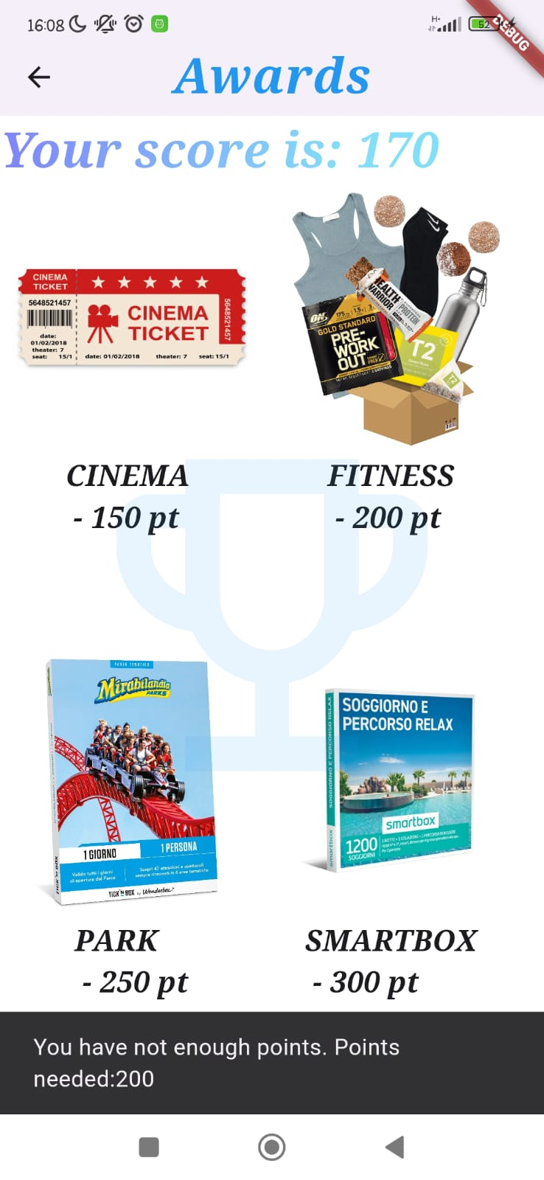
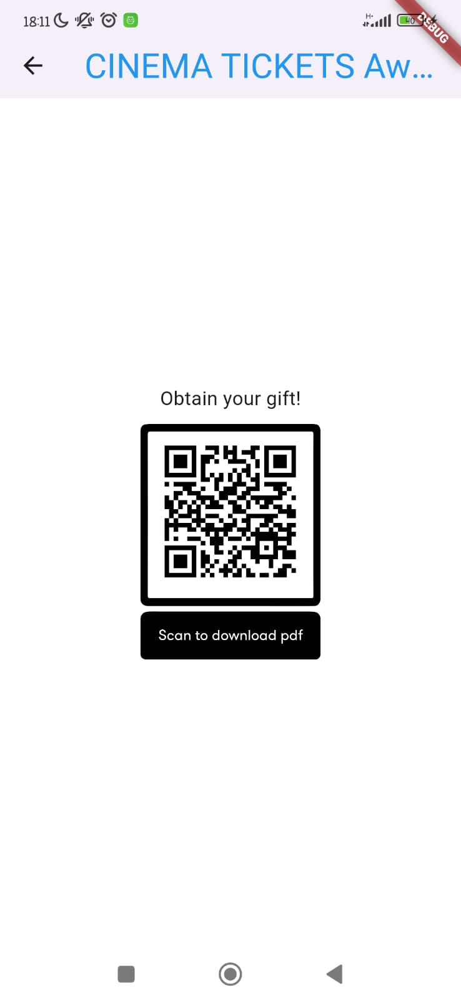
Awards & Score
Scoring system to encourage the user not to drink: using the earned points, user can access to different types of rewards. The Awards can be clicked once the score reaches the needed points.
Inside each reward page there is a QR CODE that sends to a .pdf which would represent a usable voucher.
Notes:
Award and score: We have created a scoring system that motivates the user not to drink or use substances (as explained on the Today page), giving points if he does not drink/use substances and deducting points if he drinks/uses them
Furthermore, through the DailyQuiz you can earn other points
The points system is motivated by the fact that the user has access to different types of rewards, which are unlocked when they reach the necessary score and can be clicked on the Awards page.
The prizes are: .....
Inside each reward page there is a QR CODE that sends to a pdf which would represent a usable voucher

Slide 16


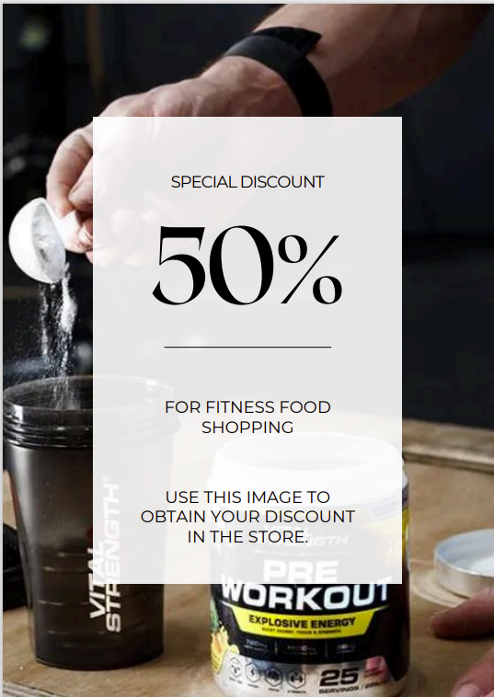
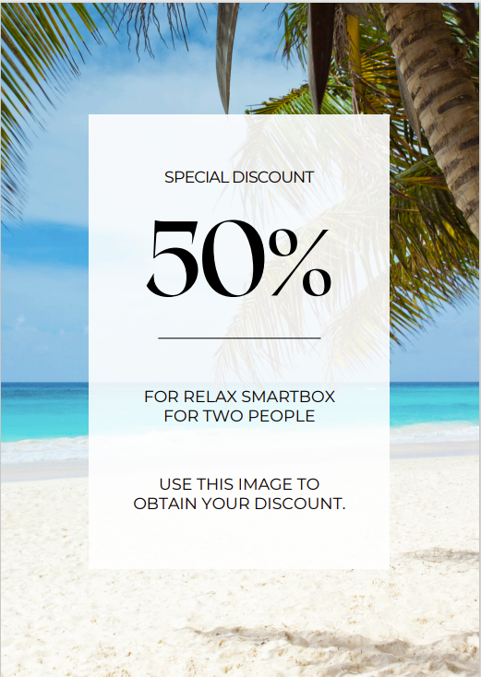
Awards & Score
Notes:
Award and score: We have created a scoring system that motivates the user not to drink or use substances (as explained on the Today page), giving points if he does not drink/use substances and deducting points if he drinks/uses them
Furthermore, through the DailyQuiz you can earn other points
The points system is motivated by the fact that the user has access to different types of rewards, which are unlocked when they reach the necessary score and can be clicked on the Awards page.
The prizes are: .....
Inside each reward page there is a QR CODE that sends to a pdf which would represent a usable voucher

Slide 17
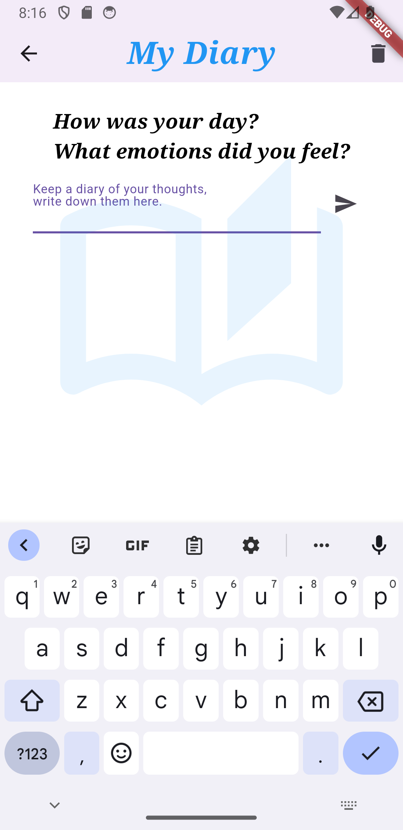
Other implemented pages
MyDiary: personal place where the user can freely write his thoughts, reflections and progress on his journey, helping him to better understand his feelings and behaviors.
Notes:
MyDiary: personal place where the user can freely write his thoughts, reflections and progress on his journey, helping him to better understand his feelings and behaviors.
Having a private corner can be an effective method to keep track of the overcome difficulties.

Slide 18
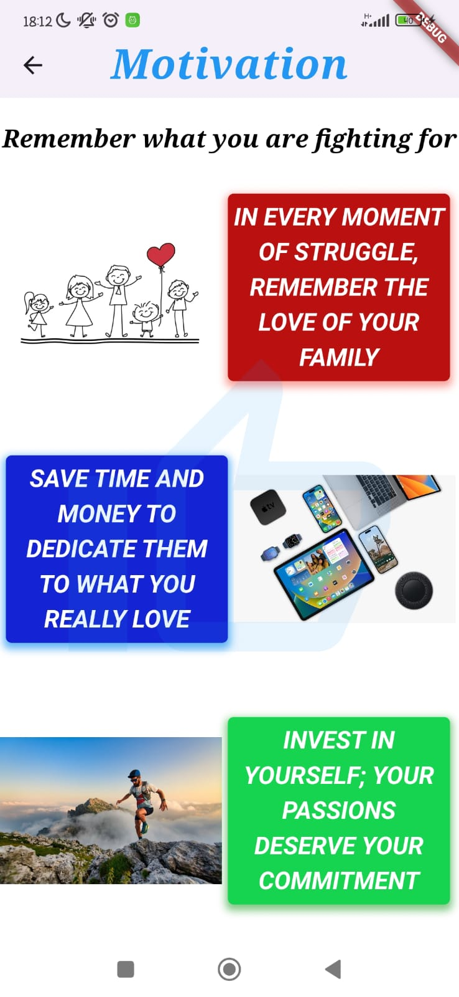
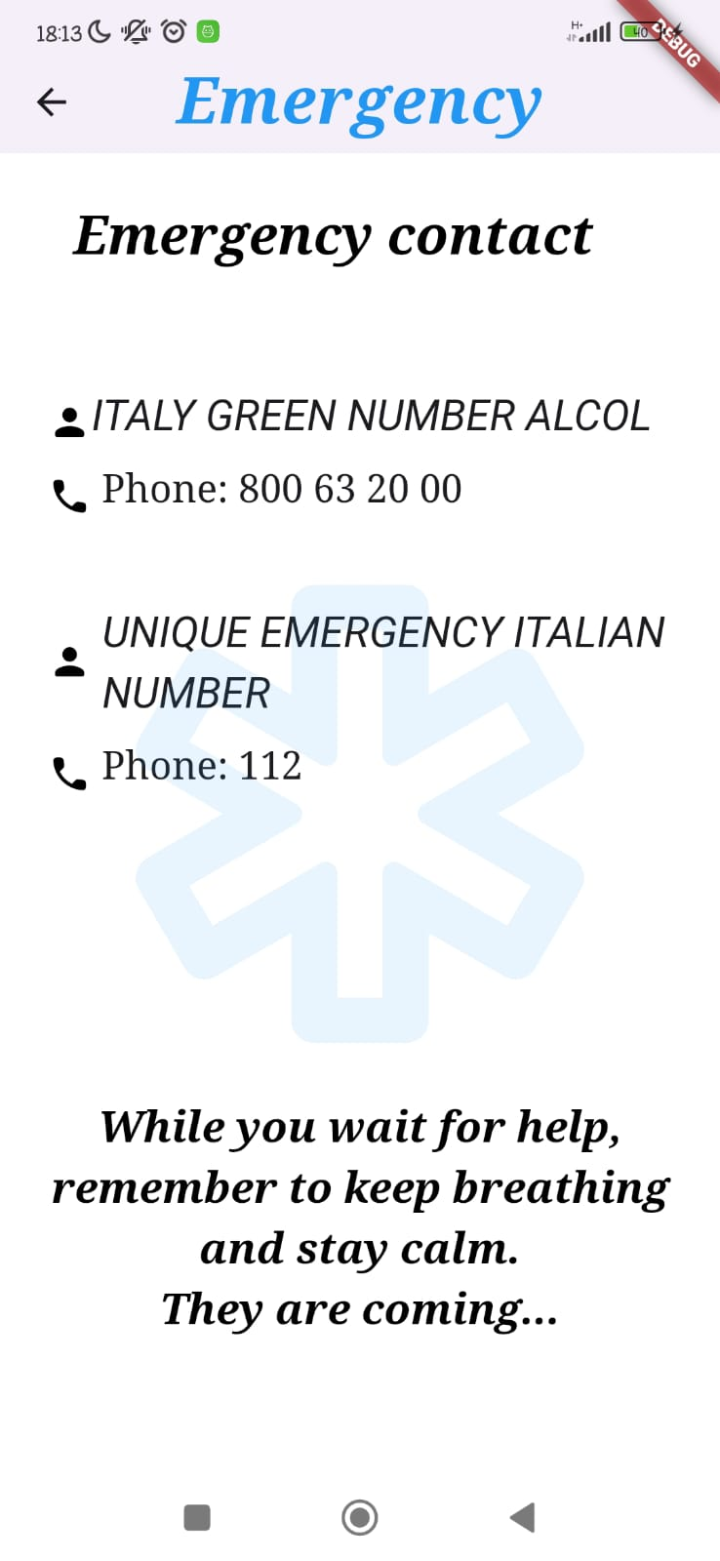
Other implemented pages
Emergency: emergency contact if the user needs them.
Motivation: visual board of the most important things for the user.

Slide 19
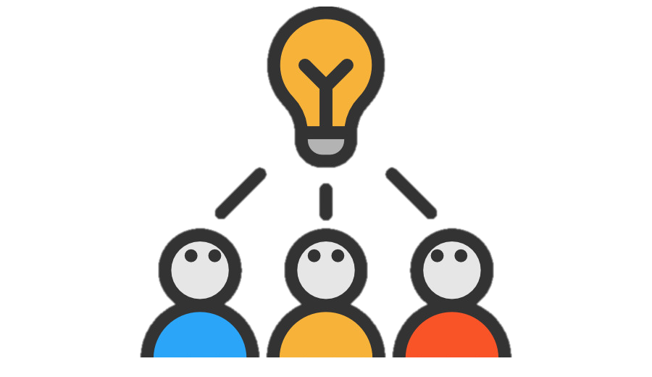
Discussion
Implementing a points system with rewards to encourage users to achieve their goals and change their lifestyle can be an effective strategy.
However, we are aware of the limitations that come from monitoring only certain personal data, which may not fully represent conditions related to substance abuse.
Notes:
Closing remarks and future developments – Sum up you discussion briefly. What are the possible evolution of your app in the future? …

Slide 20
Future developments
Monitoring: to track user’s data up to that moment of the day.
Daily Quiz: to implement a DB of questions so that every day, the application can randomly select 6 different questions for the user to answer.
Awards: to offer significant rewards even for relatively low point threshold.
Motivation: to allow the user to enter their passions and what is important to him/her and using this information, displaying relevant content.
MyDiary: to include the date and time when each entry is written.
Emergency: to add his/her own emergency contact and to make all of them directly clickable within the application.
Notes:
Closing remarks and future developments – Sum up you discussion briefly. What are the possible evolution of your app in the future? …

Slide 21
Future developments
Calendar: to implement a calendar that logs daily data up to the current day, highlighting in green the days when the user (presumably) did not drink and in red the other days.
ChatSponsor: to implement a chat feature that allows users to communicate with her/his sponsor to provide advice and assistance in times of needs.
Community: to implement a chat feature that allows users to communicate with her/his anonymous friends of ex-alcoholic support group.
Notes:
Closing remarks and future developments – Sum up you discussion briefly. What are the possible evolution of your app in the future? …

Slide 22
Thanks for your attention
Stay the Course, trying to do your best!

